Slide 1
Sustainable ICT Strategies in the Irish Public Sector
Orla Conduit

Slide 2
“I just took it as a given that digital was green, but the more I researched, the more the underside of digital emerged, the more I have come to believe that digital is a hidden accelerant of global warming, and a driver of a whole range of really bad human habits.”
-Gerry McGovern
Author
Notes:
Anyone who was at this conference last year, will remember Gerry McGovern, speaking to us about the environmental impact of our industry.
As I recall, that seemed to come as quite the eye-opener for many people in the room. There was sort of a stunned silence, as a very large penny dropped…

Slide 3
ICT Climate Impact Drivers
Jevon’s Paradox
In use
Disposal
Embedded
AI

Slide 4
“If Microsoft is shooting for the moon on decarbonization, the moon is “more than five times as far away as it was in 2020”
-Brad Smith
Microsoft President

Slide 5
What are we doing about it?

Slide 6
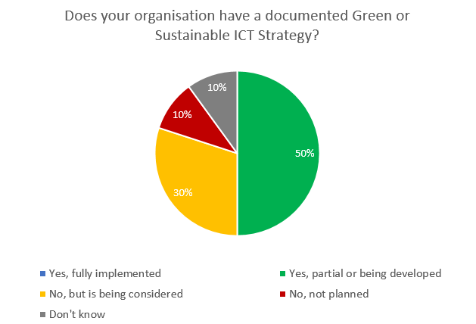
Have a strategy…

Slide 7
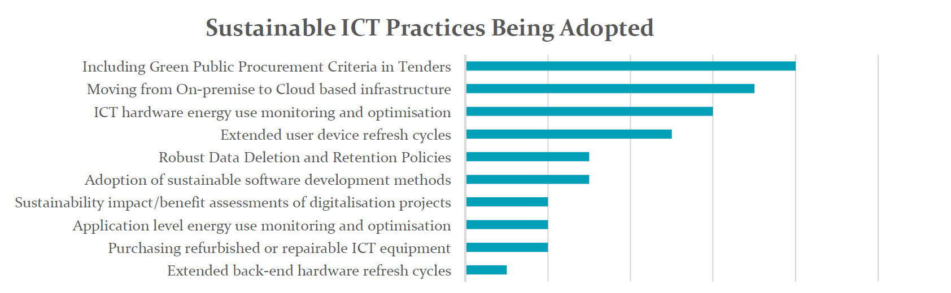
Adopt best practices….
0% | 20% | 40% | 60% | 80% | 100%

Slide 8
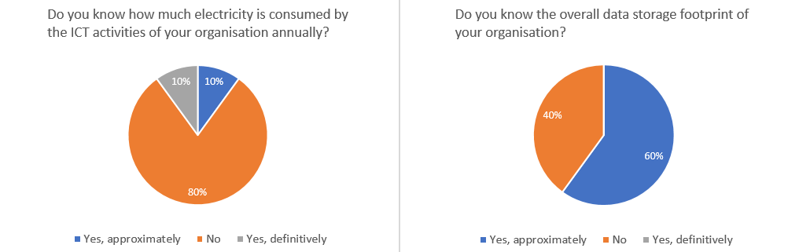
Quantify…..

Slide 9
What Next?
……….keep the conversation going.

Slide 10
Thank you.

